Slide 1
Introduction to Cancer Epigenetics
Nov 02 2025
Phuc Loi Luu, PhD
Email: luu.p.loi@googlemail.com
Zalo: 0901802182

Slide 2
Outline
Human genome
Cell structure and function, Eukaryotic vs Prokaryotic
Chromatin organization
Central Dogma
Germline development?
What is Epigenetics?
Genomics vs Epigenetics
How does Epigenome regulate transcription?
Epigenetic Mechanisms in Gene Regulation
Some examples of epigenetic applications in clinical

Slide 3
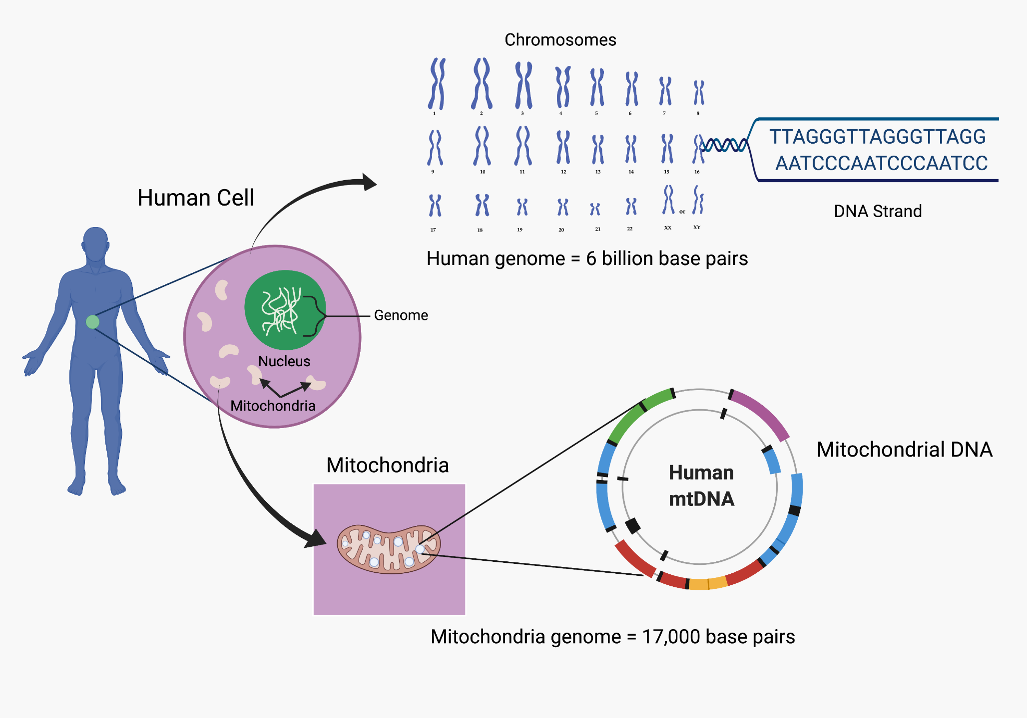
https://www.fjc.gov/content/361230/DNA-basics-nucleotides-genes-genome

Slide 4
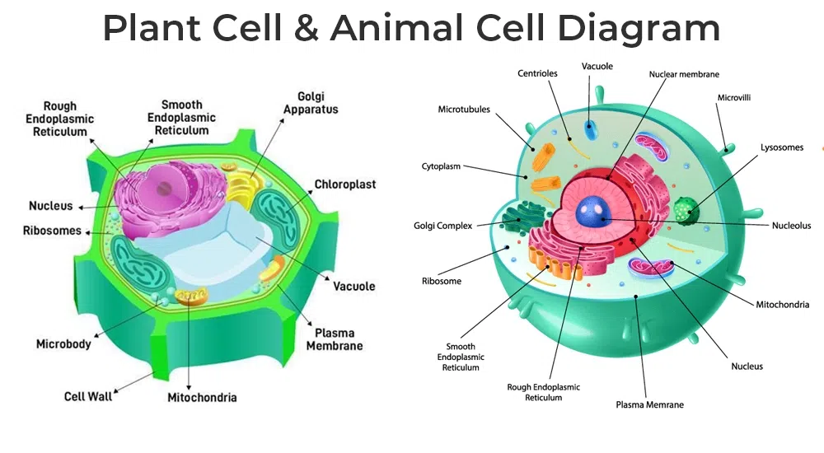
Cell structure and function
https://www.geeksforgeeks.org/biology/cell-structure-function/

Slide 5
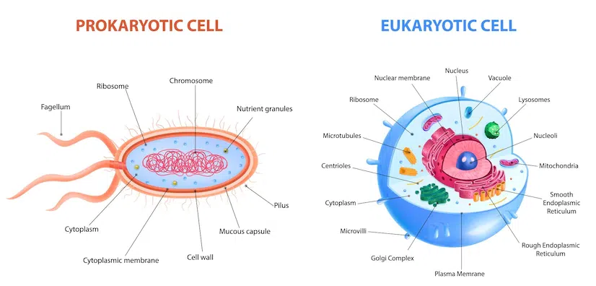
Eukaryotic vs Prokaryotic
https://www.geeksforgeeks.org/biology/cell-structure-function/

Slide 6
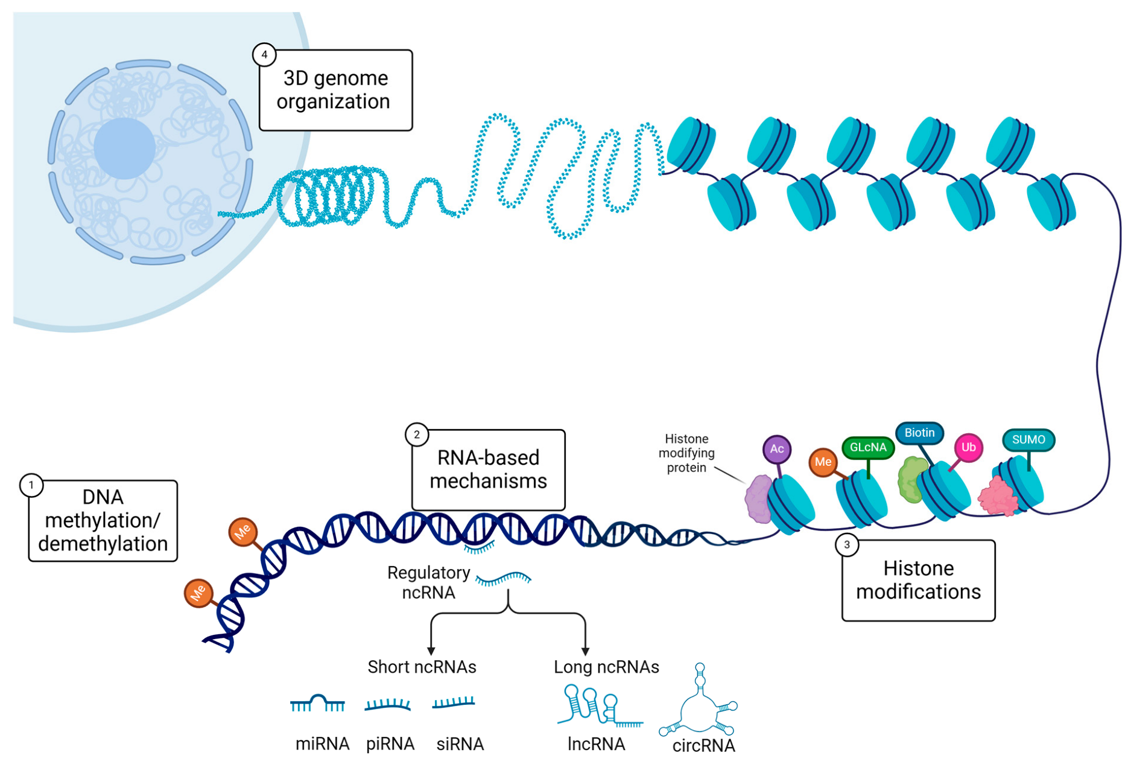
Chromatin organization
https://doi.org/10.3390/ijms26073075

Slide 7
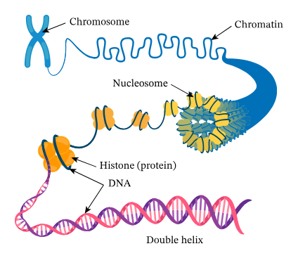
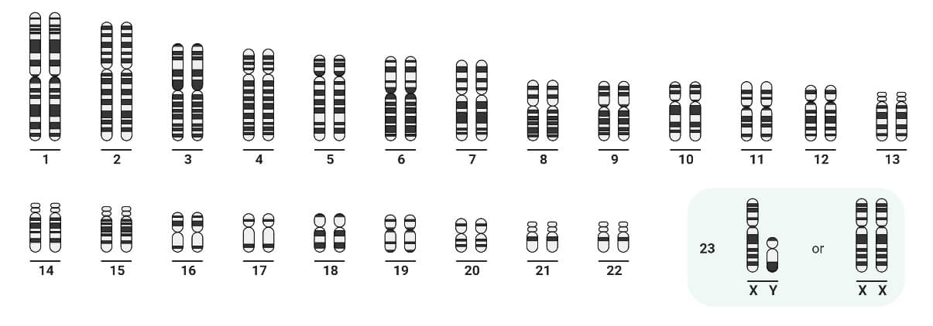
Human Karyotype
https://microbenotes.com/karyotype-karyotyping/

Slide 8
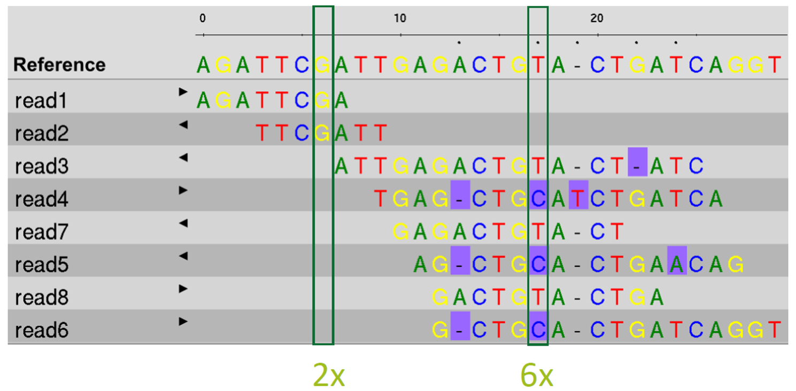
Kết quả của mapping

Slide 9
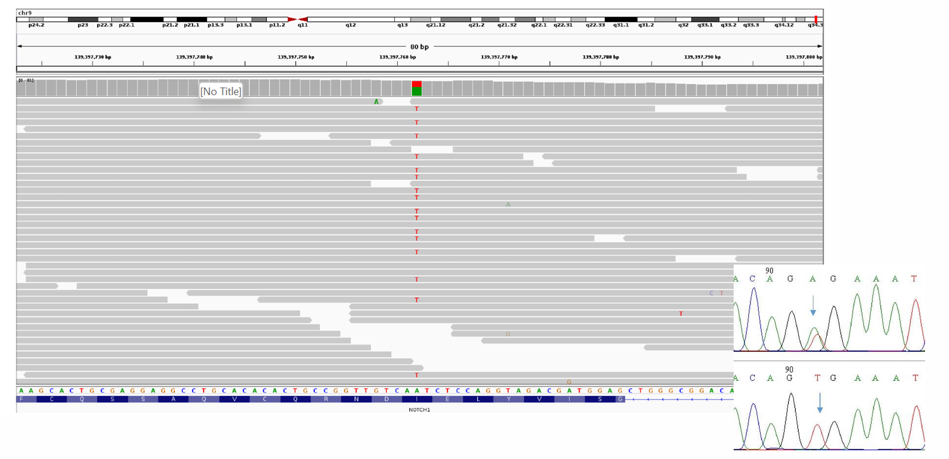
DNA Mutation

Slide 10
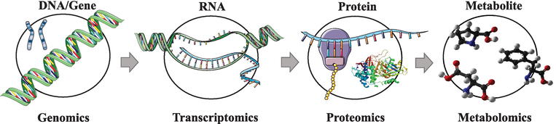
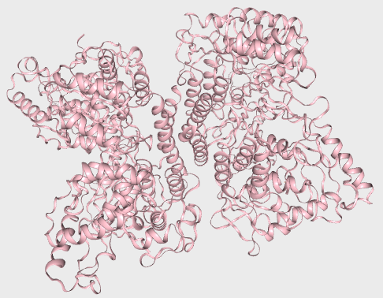
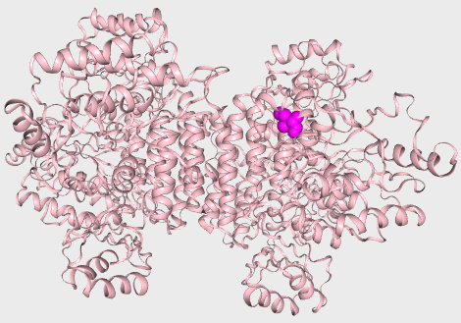
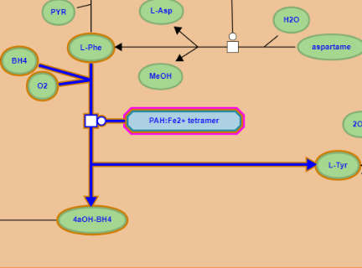
Central Dogma
PAH gene
Ref …ATCGAT…
P1 …AACGAT…
NM_000277.3(PAH):c.971T>A
PAH mRNA
Ref …AUCGAU…
P1 …AACGAU…
NM_000277.3(PAH):c.971T>A
PAH protein
Ref …Ile-Asp…
P1 …Asn-Asp…
NM_000277.3(PAH):p.Ile324Asn
PAH
Ref Phe → Tyr
PAH
P1 Phe → Tyr
10.5772/intechopen.71769

Slide 11
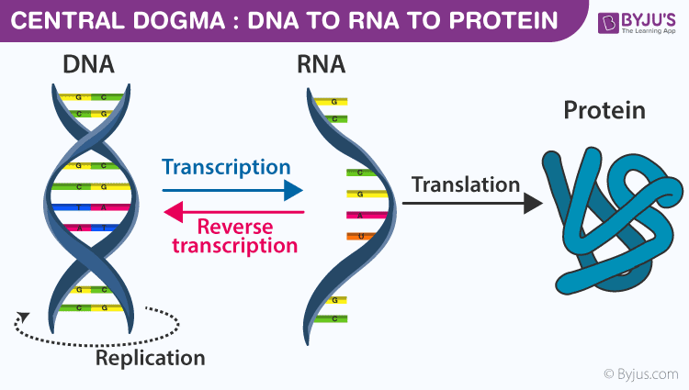
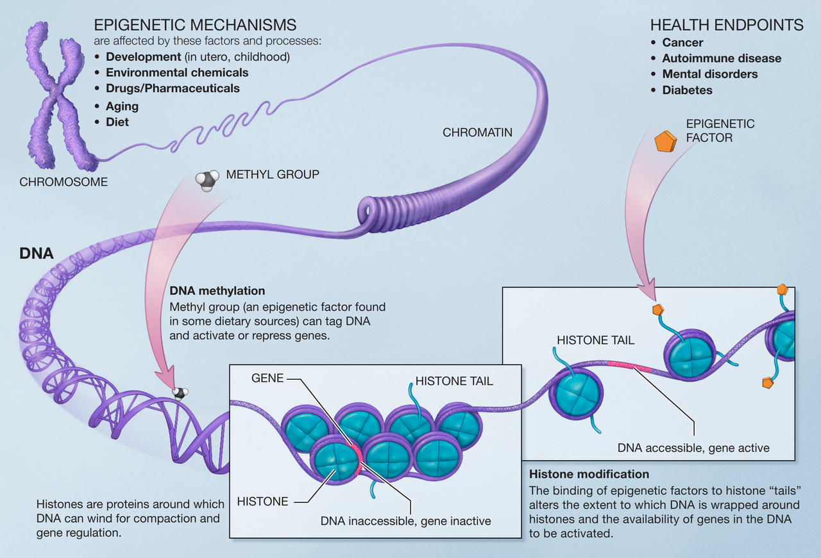
What is Epigenetics?
Your genes play an important role in your health
Your behaviors and environment can cause changes that affect the way your genes work
Epigenetics - Wikipedia

Slide 12
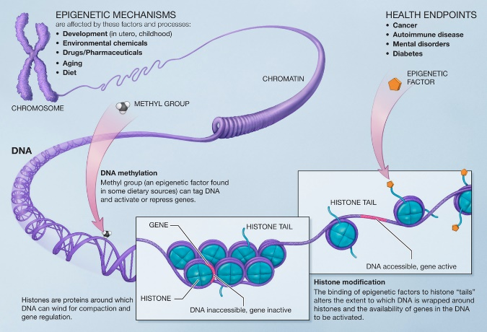
Genetics Epigenetics
Your genes play an important role in your health
Your behaviors and environment can cause changes that affect the way your genes work
Awomanwithouthermanisnothing
A woman, without her man, is nothing
A woman: without her, man is nothing

Slide 13
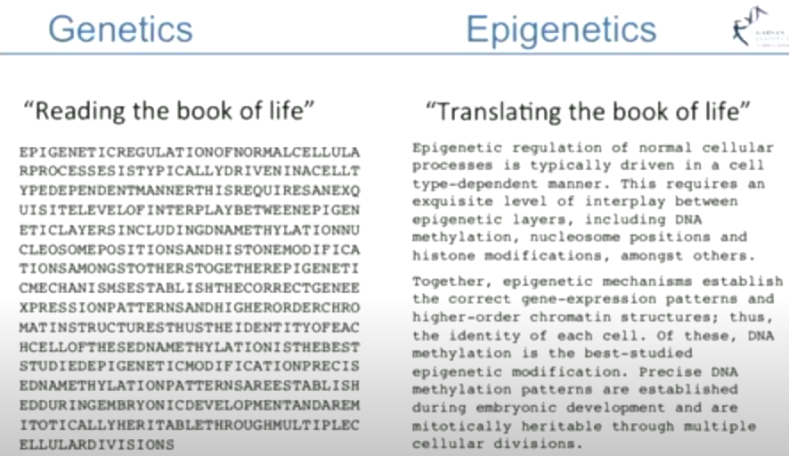

Slide 14
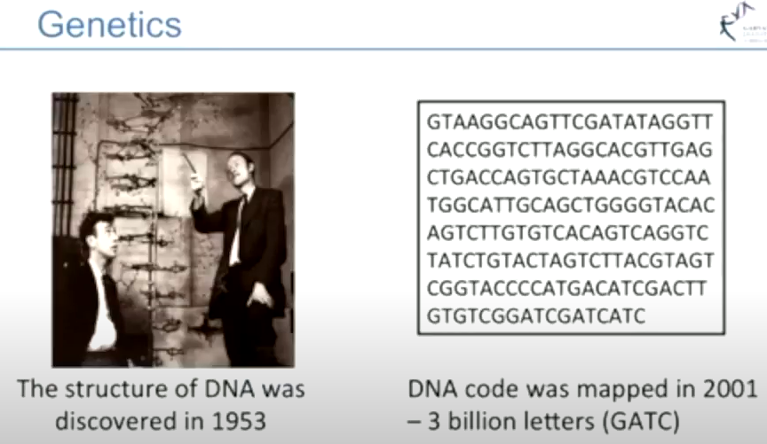

Slide 15
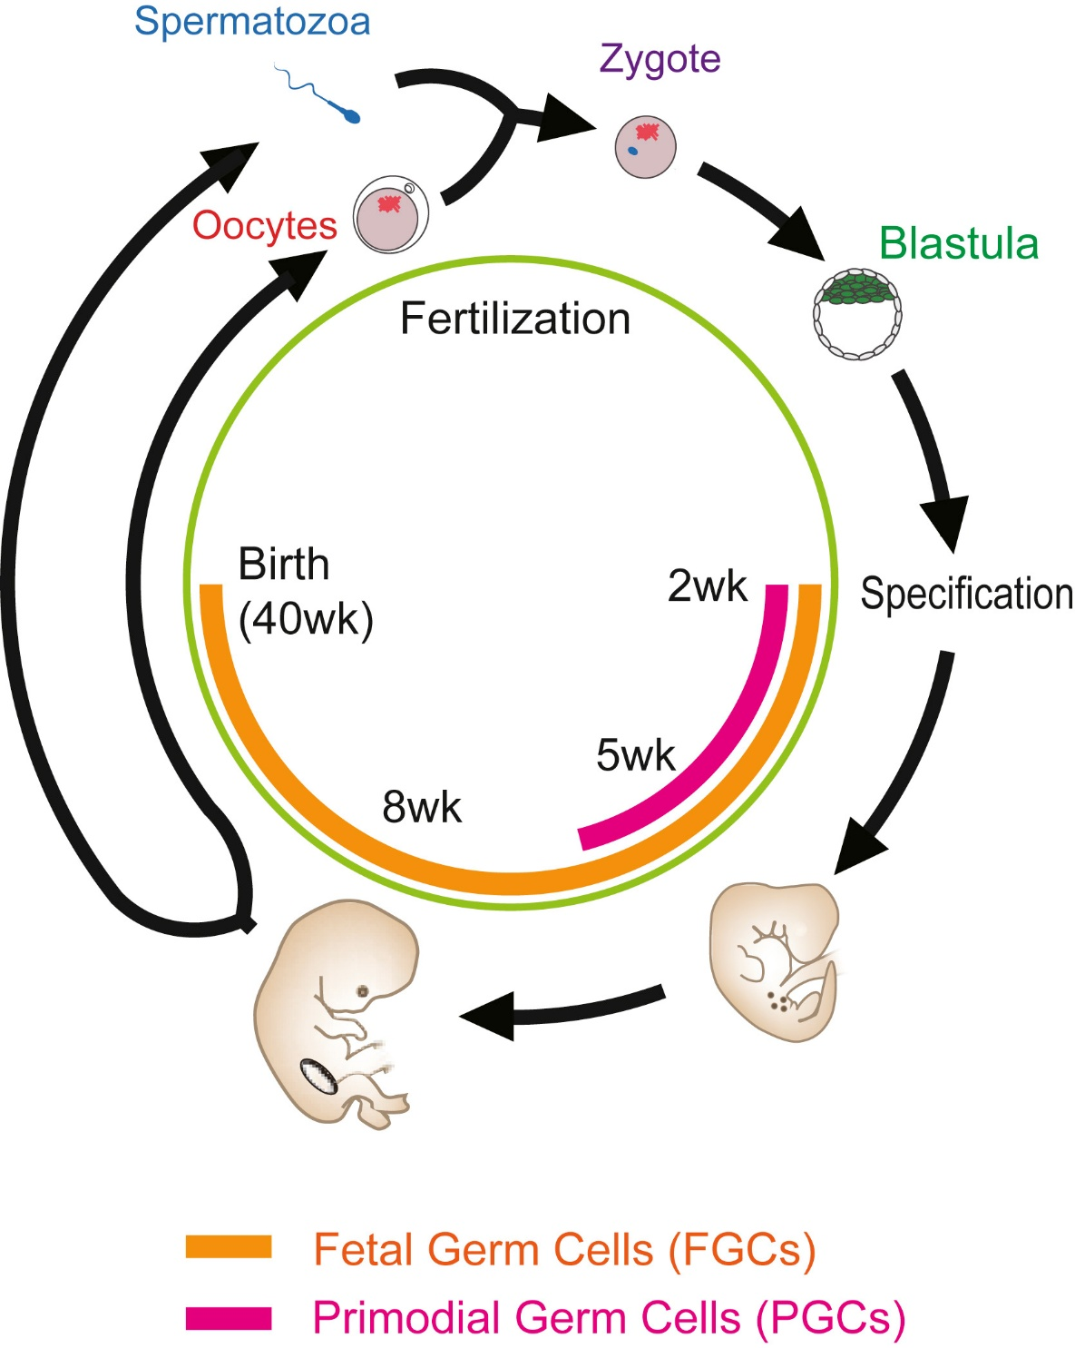

https://doi.org/10.1016/j.molcel.2019.08.025

Slide 16
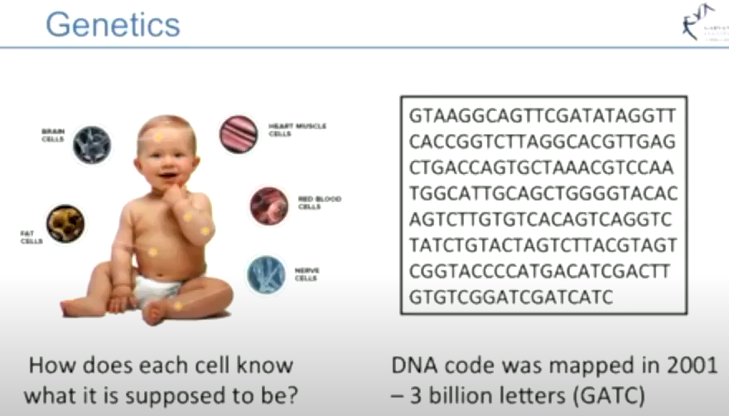

Slide 17
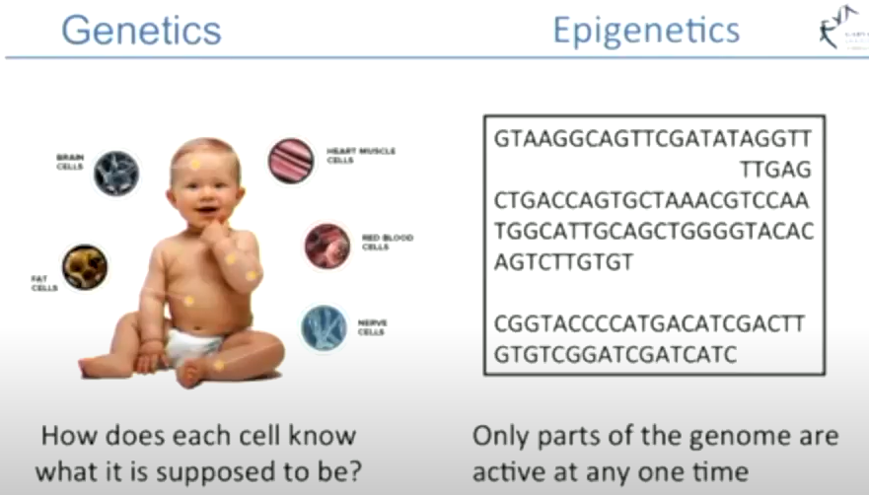
COL1A1 gene expressed in hair cells, but not brain cells

Slide 18
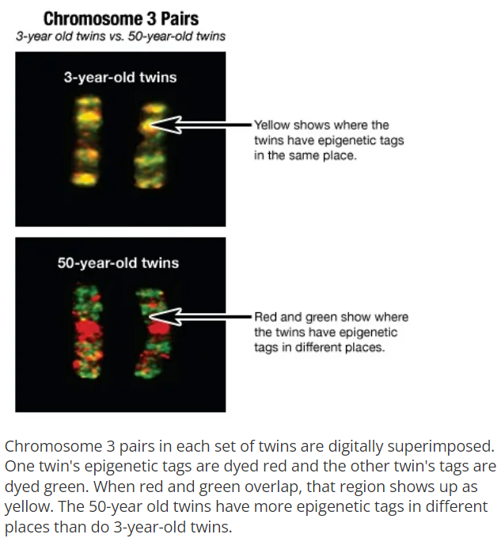
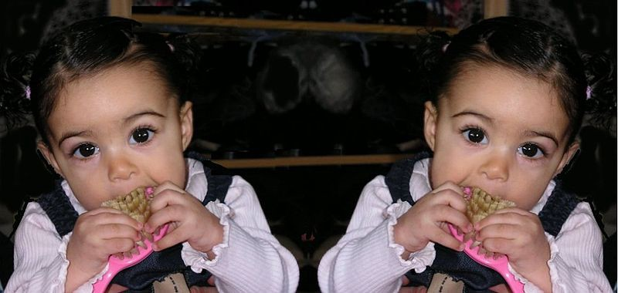
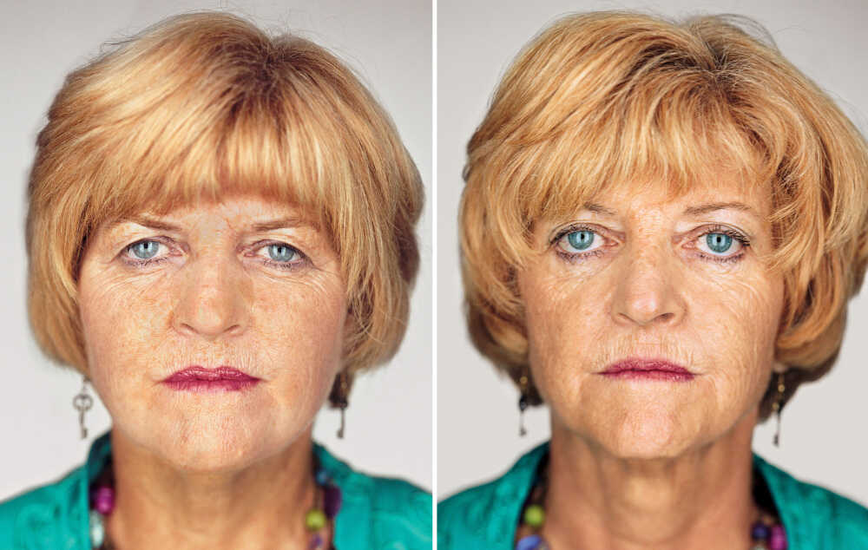
Example 1: Identical twins
Identical twins come from the same fertilized egg
→ share identical genetic profiles (genome)
→ Your behaviors and environment can cause changes that affect the way your genes work
Insights From Identical Twins (utah.edu)

Slide 19

Example 2: Identical twins 2
Identical twins come from the same fertilized egg → share identical genetic profiles (genome)
Leora Eisen
Linda Lewis
(leukemia)
→ Your behaviors and environment can cause changes that affect the way your genes work
Identical twins' differences focus of epigenetics studies | CBC News

Slide 20
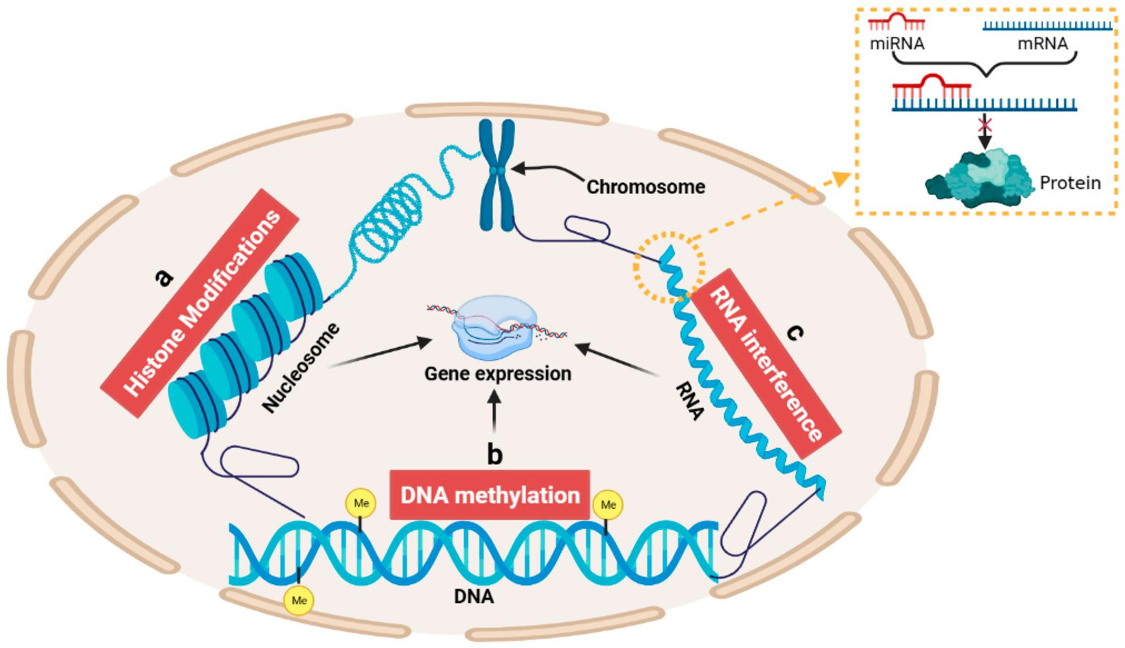
Epigenetic Mechanisms in Gene Regulation
Zhang, J.; Sheng, H.; Hu, C.; Li, F.; Cai, B.; Ma, Y.; Wang, Y.; Ma, Y. Effects of DNA Methylation on Gene Expression and Phenotypic Traits in Cattle: A Review. Int. J. Mol. Sci. 2023, 24, 11882.

Slide 21
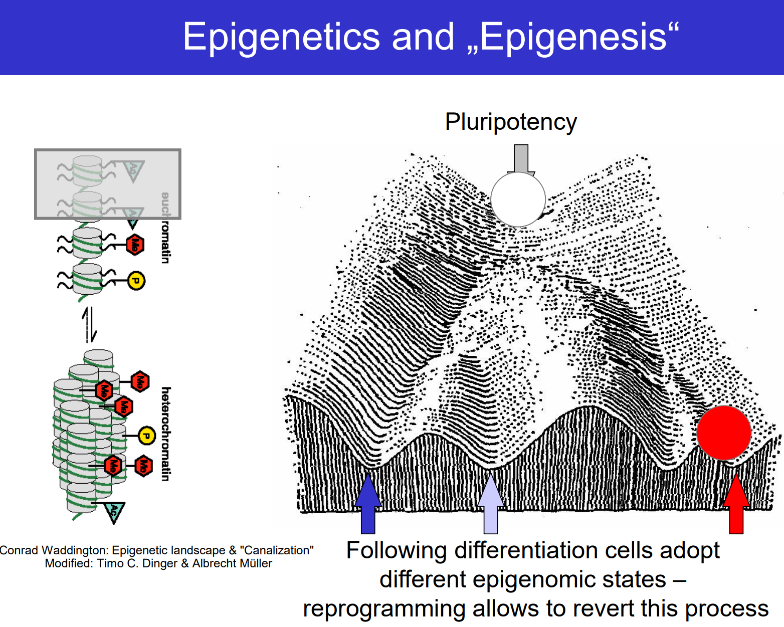

Slide 22
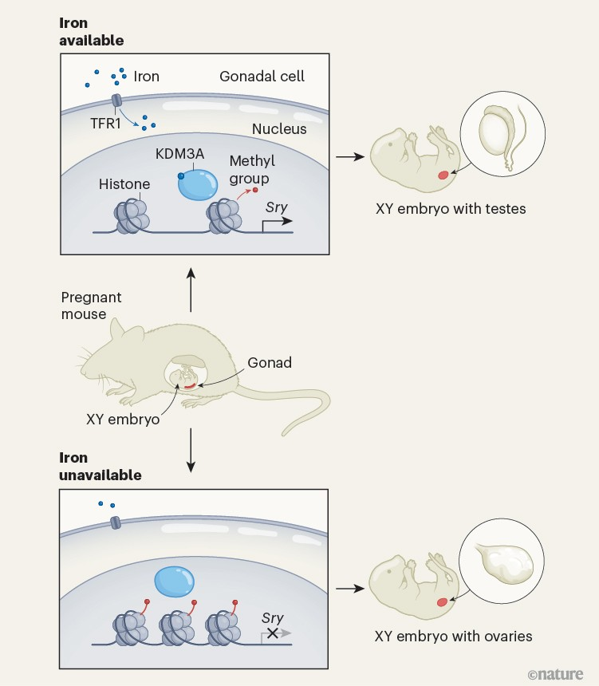
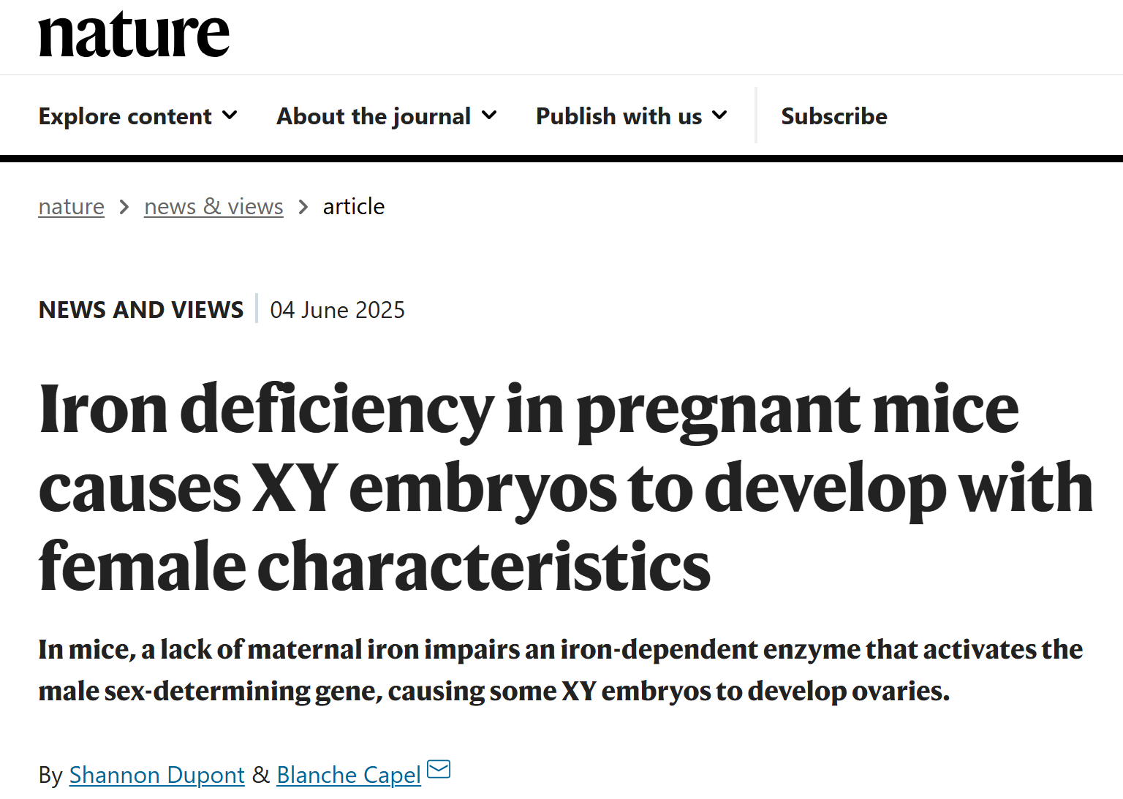

Slide 23
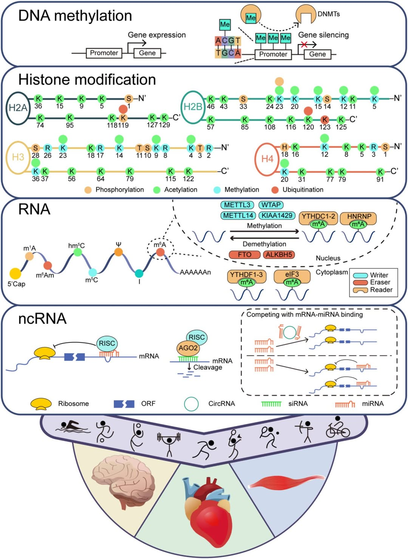
Exercise induces epigenetic modifications in skeletal muscle, brain and heart. DNA methylation, catalyzed by DNMTs, modulates gene expression through the addition and removal of methyl groups. Histone modifications, including phosphorylation, acetylation, methylation, and ubiquitination on histone tails adjust chromatin compaction, thereby regulating gene accessibility. RNA modifications, particularly m6A methylation, mediated by ‘writer’ enzymes like METTL3, reversed by ‘eraser’ enzymes such as FTO, and recognized by ‘reader’ proteins like YTHDC1-2, critically modulates mRNA stability, translation, and decay. Non-coding RNAs, such as circRNA, miRNA, and siRNA, interact with the RISC complex involving AGO2, to modulate mRNA stability and gene silencing. The nuclear and cytoplasmic distribution of these processes suggests a spatial regulation in response to exercise, collectively contributing to the enhancement of muscle performance, cognitive function, and cardiac health by precisely tuning gene expression. ME = methyl group; DNMTs = DNA Methyltransferases; RISC = RNA-induced silencing complex; AGO2 = Argonaute 2; ORF = Open reading frame
https://epigeneticsandchromatin.biomedcentral.com/articles/10.1186/s13072-025-00576-8

Slide 24
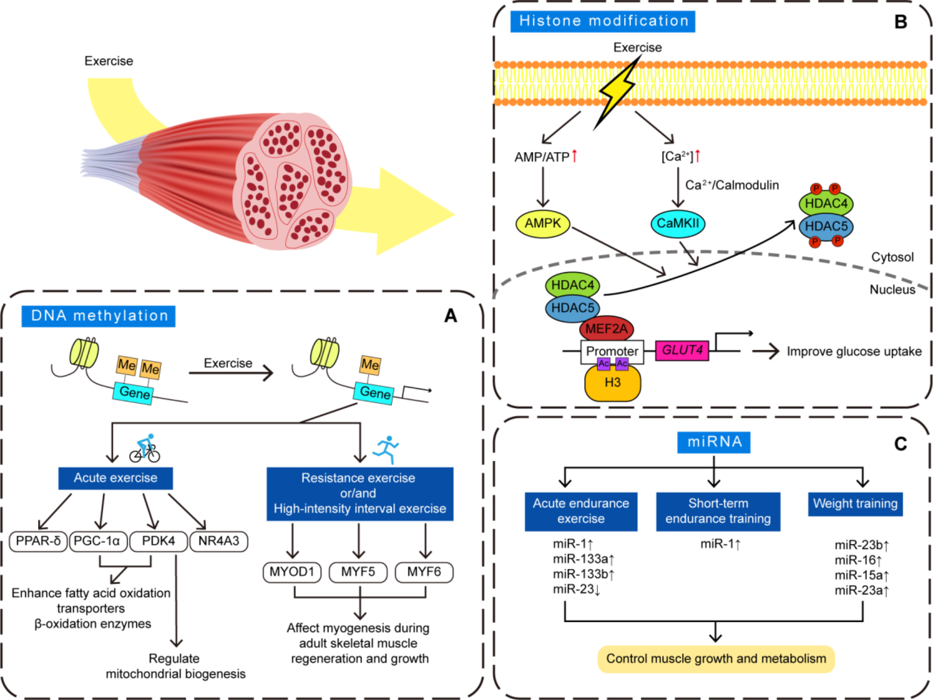
Exercise-induced epigenetic changes in skeletal muscle. (A) DNA Methylation: Exercise induces changes in DNA methylation patterns that regulate gene expression. (B) Histone Modification: Exercise increases AMPK activation through AMP/ATP ratio changes and calcium signaling via CaMKII. These pathways lead to the phosphorylation of HDAC4 and HDAC5, which promote MEF2A-dependent activation of the GLUT4 promoter, improving glucose uptake and enhancing metabolic adaptations. (C) miRNA Regulation: Different types of exercise, such as acute endurance exercise, short-term endurance training, and weight training, influence the expression of specific miRNAs, which play crucial roles in regulating muscle growth and metabolism

Slide 25
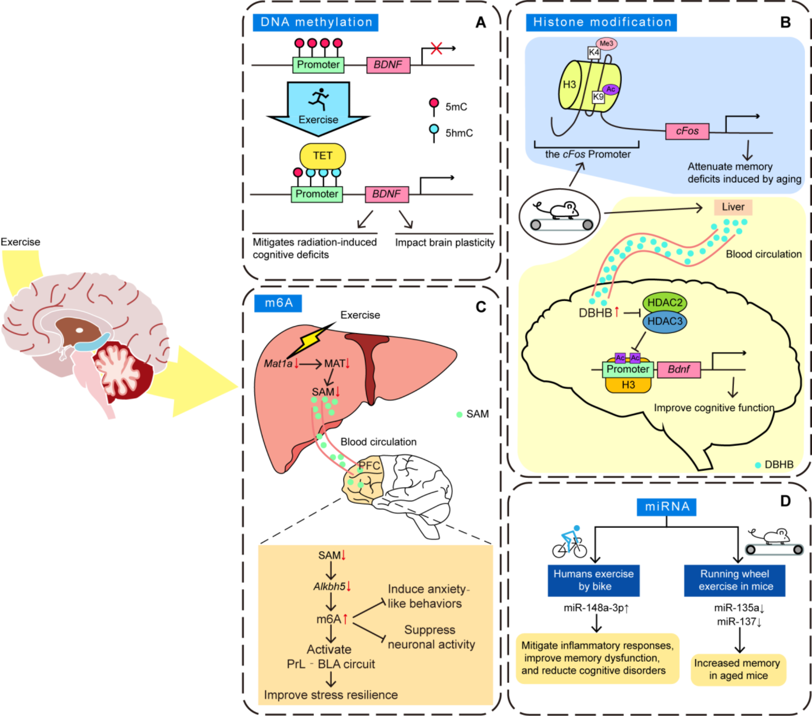
Exercise-induced epigenetic changes in the brain. (A) DNA Methylation: Exercise induces changes in DNA methylation that regulate gene expression, such as in the BDNF promoter. (B) Histone Modification: Exercise influences histone modifications in various brain regions, such as the cFos promoter in the hippocampus, which attenuates memory deficits induced by aging. Additionally, HDAC2 and HDAC3 are involved in promoting BDNF expression, enhancing cognitive function via circulating molecules like DBHB. (C) m6A RNA Methylation: Exercise affects brain m6A levels through hepatic biosynthesis of SAM, influencing anxiety-like behaviors and neural activity, improving stress resilience. (D) miRNA Regulation: Exercise alters the expression of specific miRNAs in the brain

Slide 26
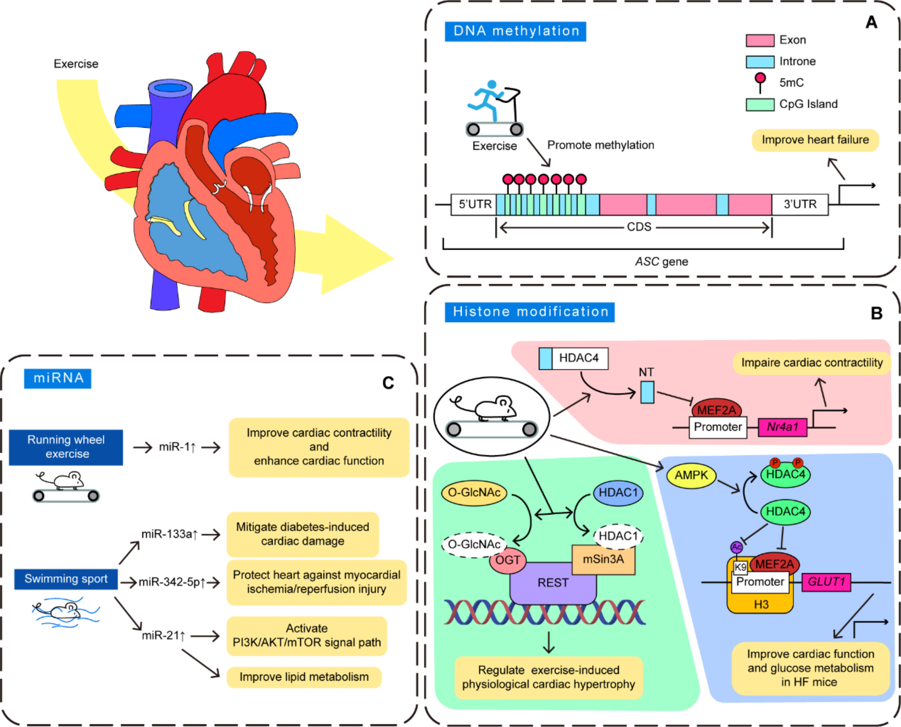
Exercise-induced epigenetic changes in the heart. (A) DNA Methylation: Exercise influences methylation status of the ASC gene, thereby regulating its expression and improving heart failure. (B) Histone Modification: Exercise triggers histone modifications that affect cardiac function. (C) miRNA Regulation: Specific types of exercise, such as running wheel and swimming, modulate the expression of certain miRNAs that play crucial roles in cardiac health

Slide 27
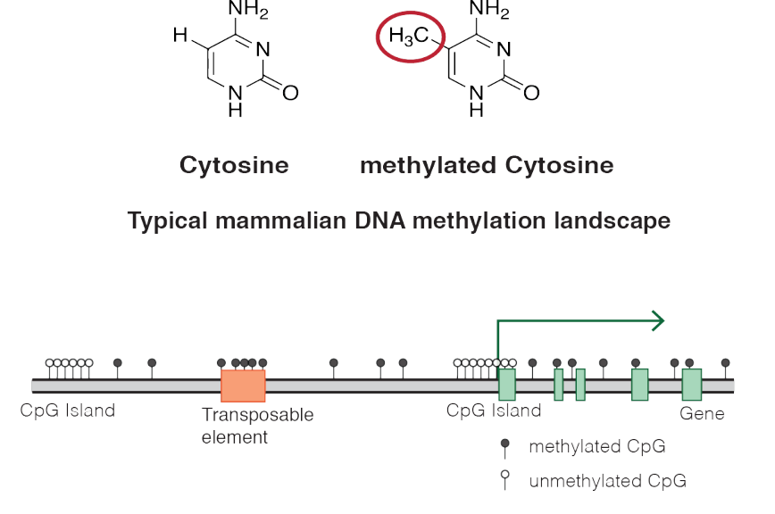
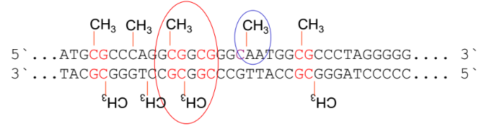
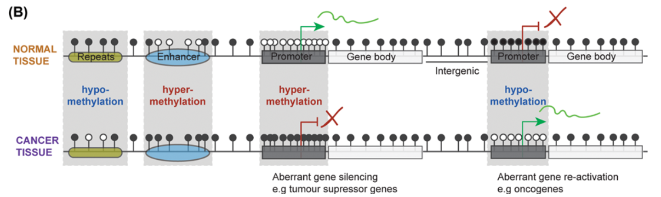
What are DNA Methylation and genome-wide DNA methylation (Epigenome)?
https://en.wikipedia.org/wiki/DNA_methylation

Slide 28
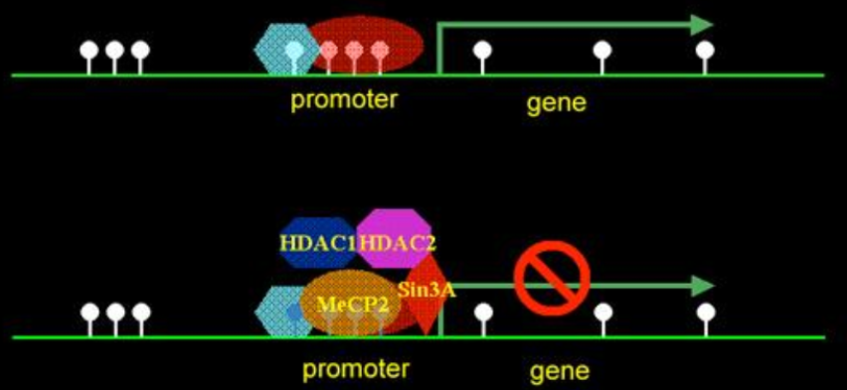
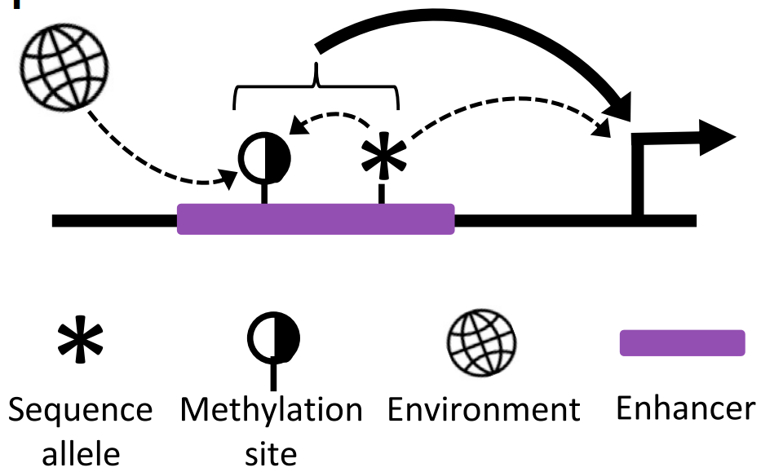
DNA methylation regulates gene expression
Promoter
Enhancer
Methylated CpG site
10.1016/j.cell.2013.06.018

Slide 29
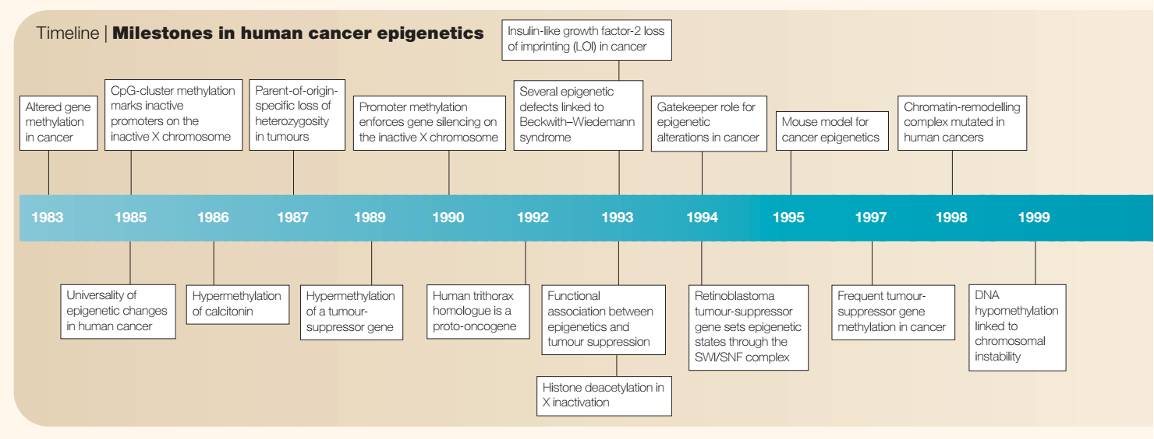
DNA methylation regulate gene expression in cancer
10.1038/nrc1279

Slide 30
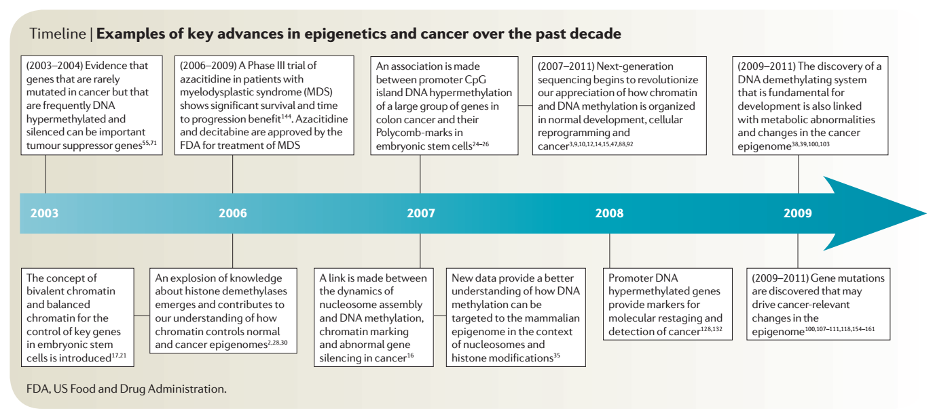
DNA methylation regulate gene expression in cancer
10.1038/nrc3130

Slide 31
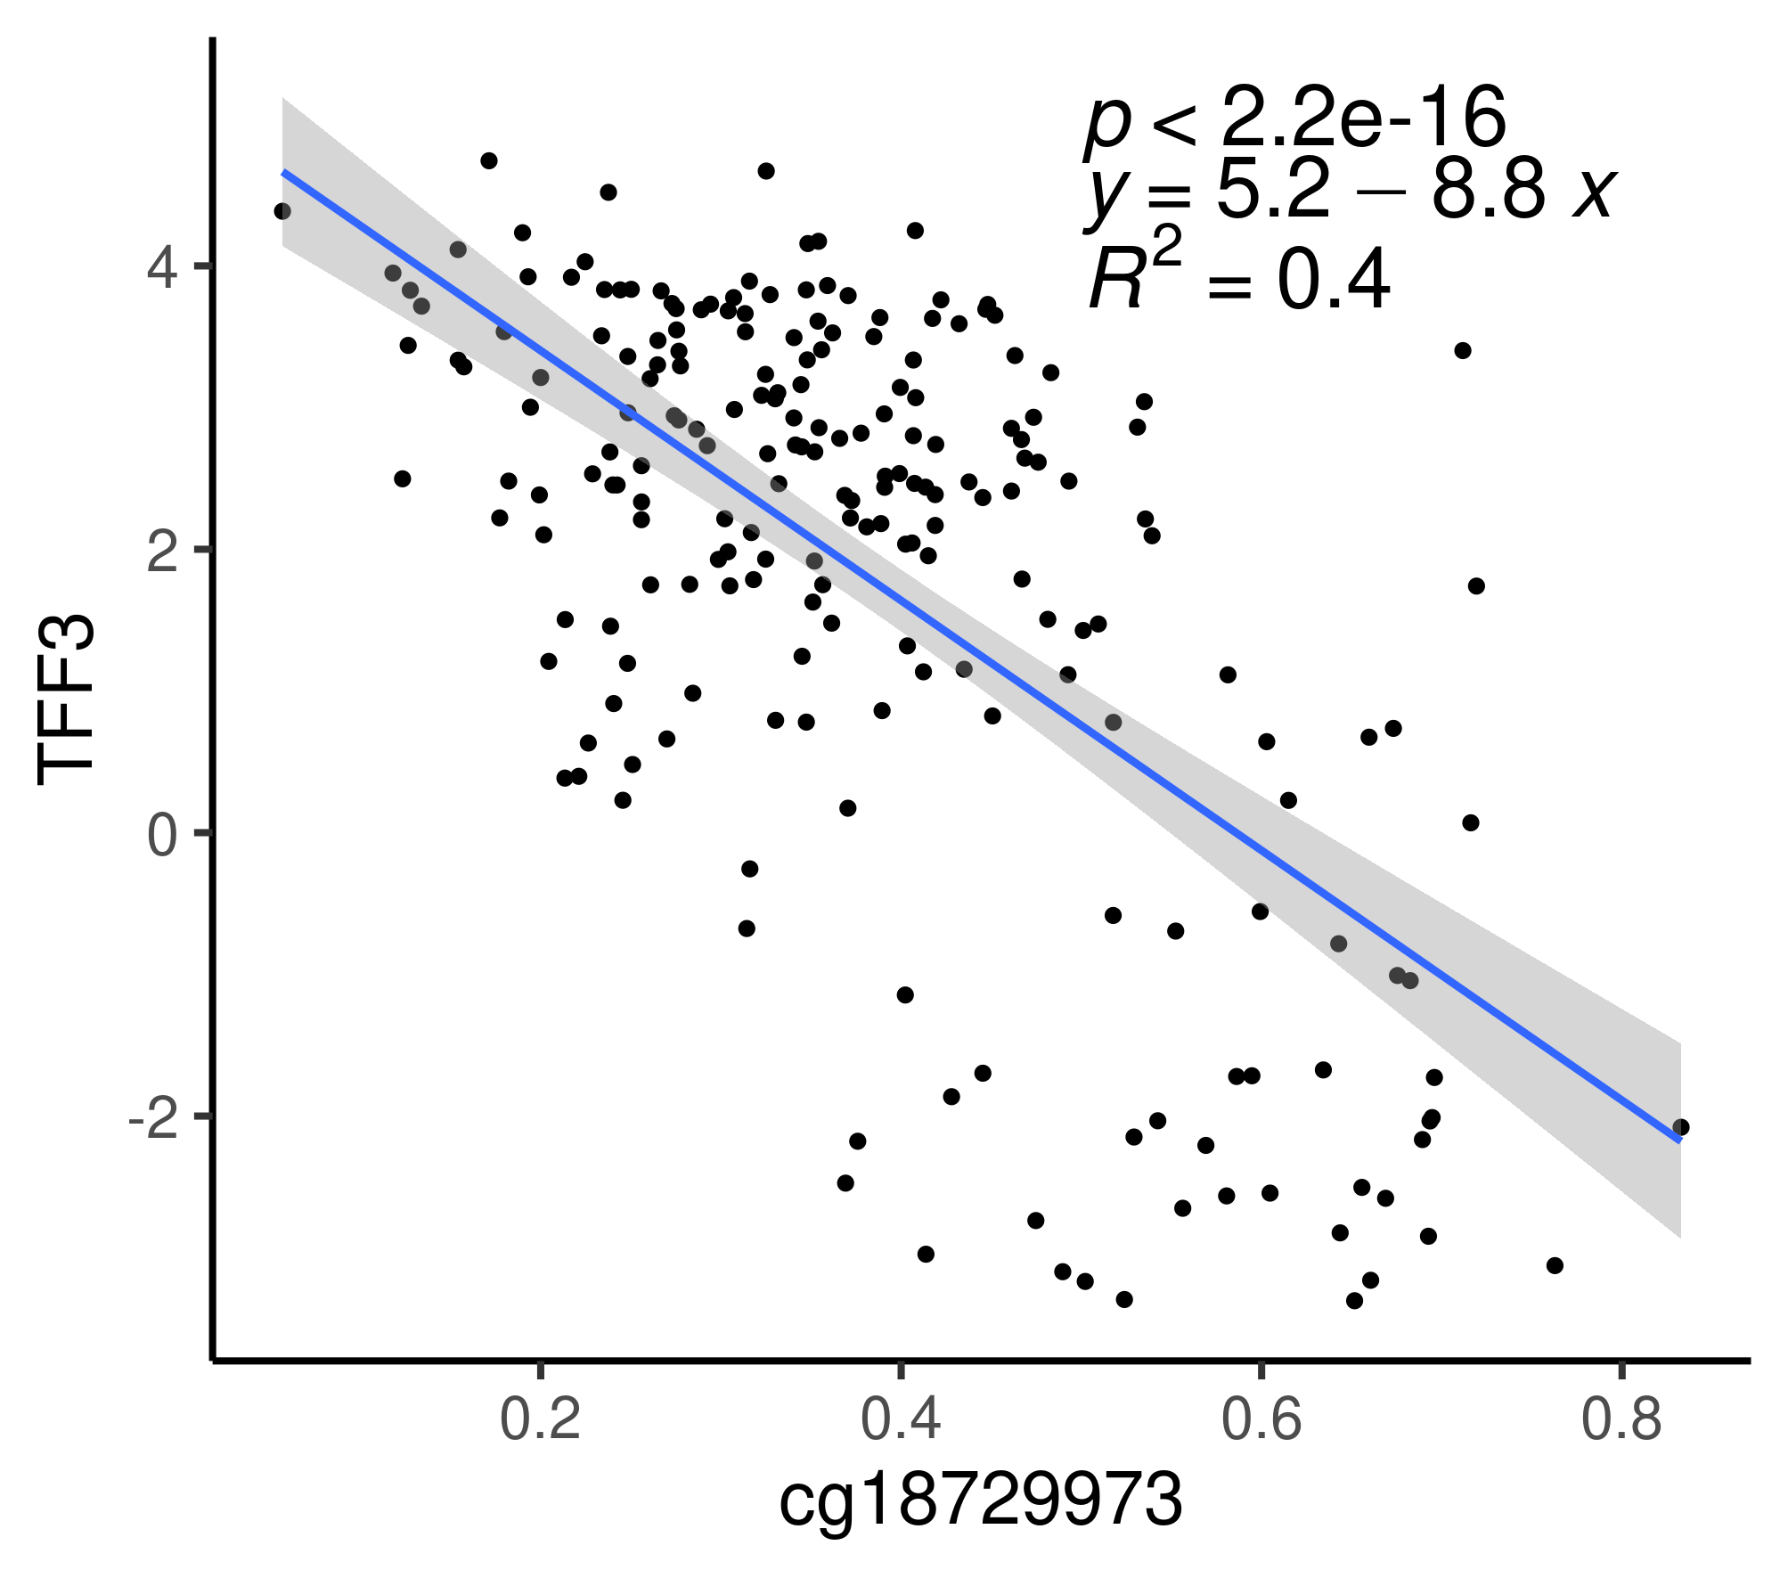
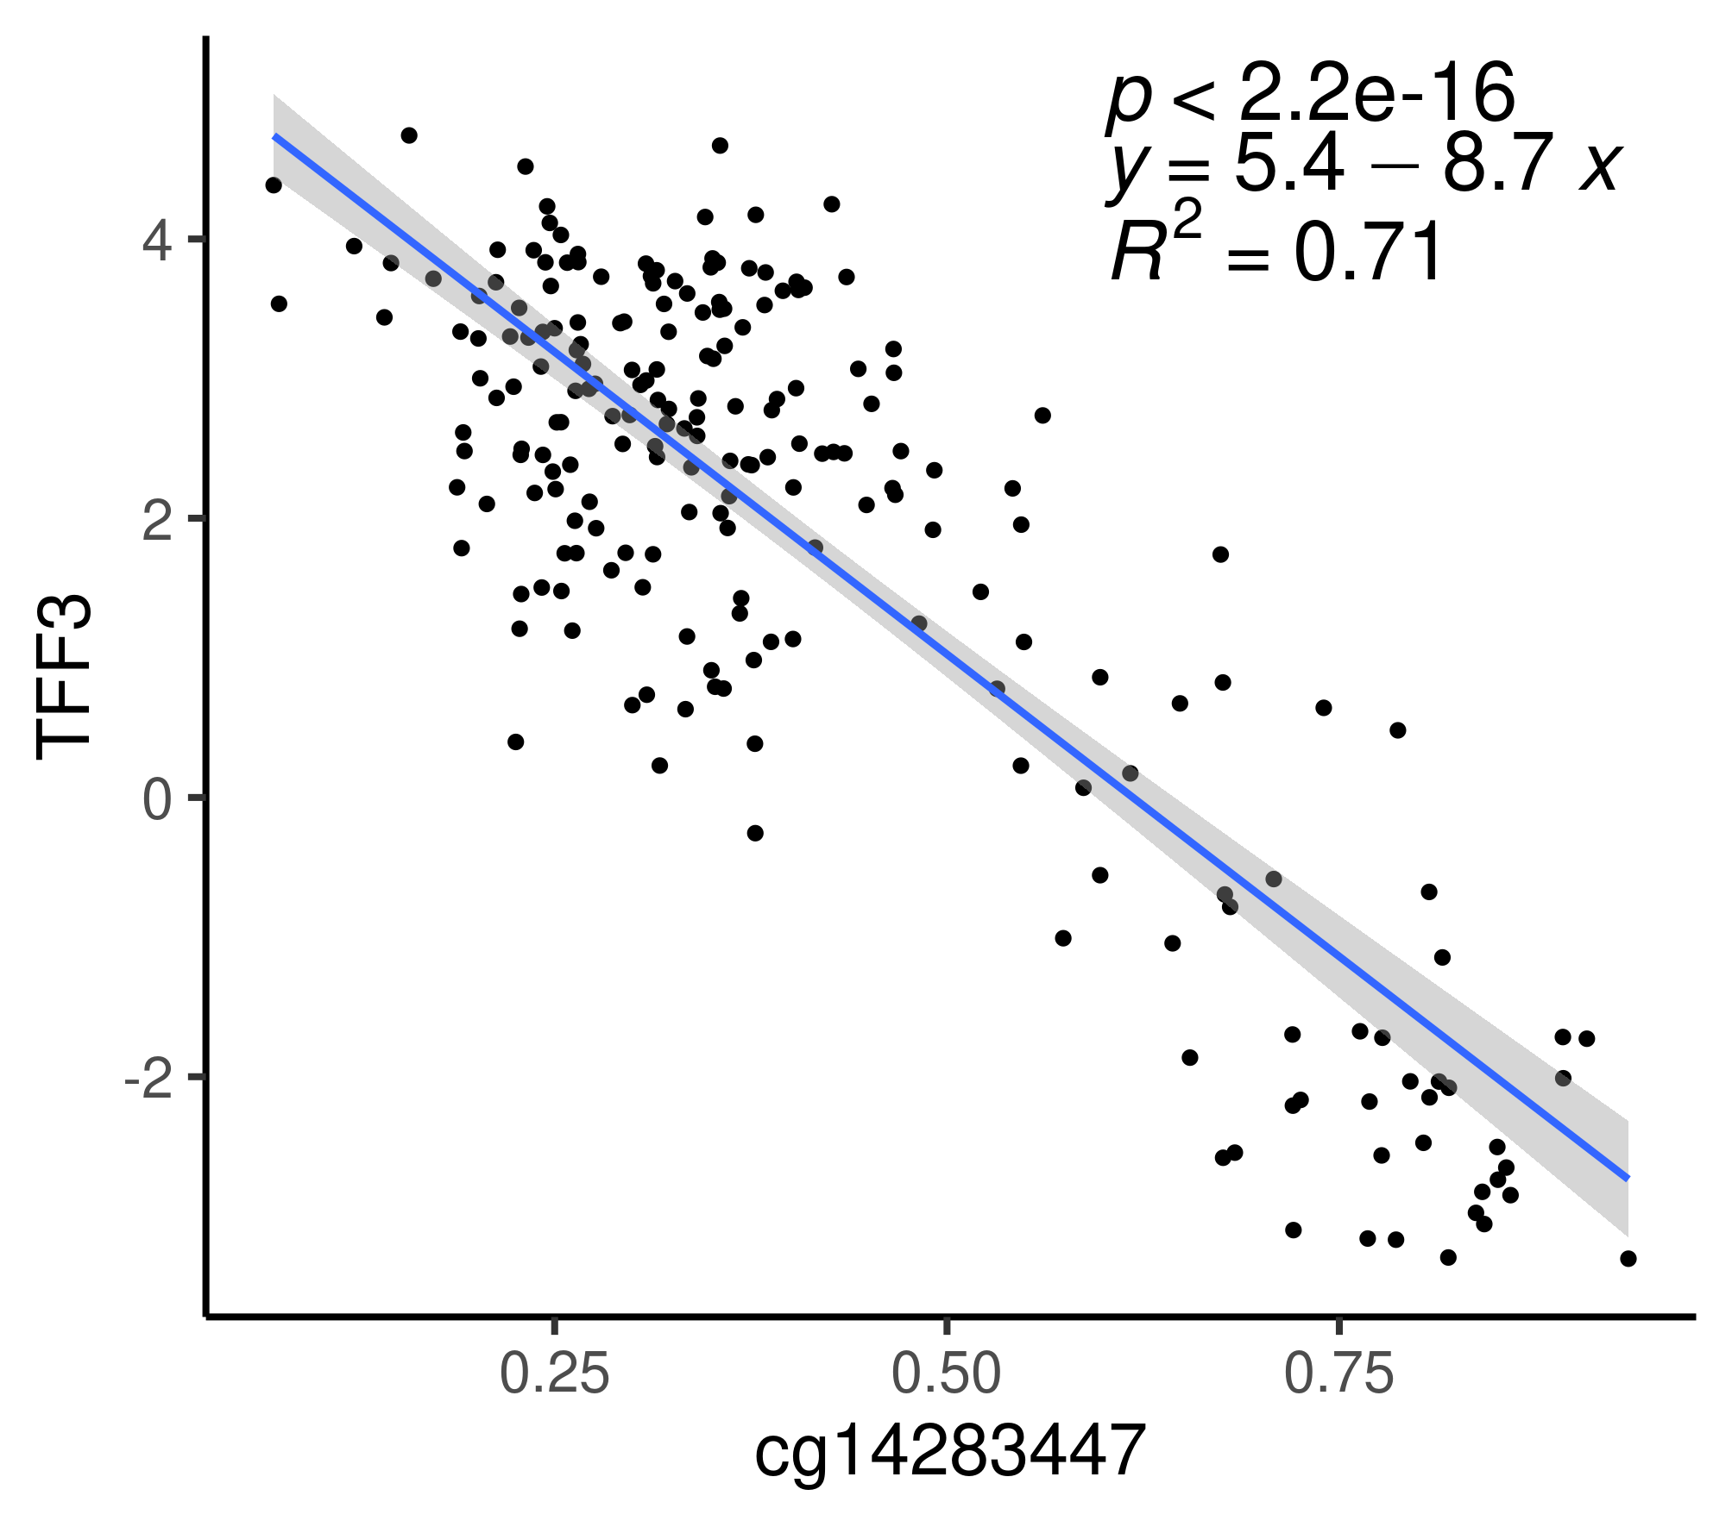
DNA methylation regulate gene expression in cancer
Expression
DNA methylation
10.1042/EBC20190037

Slide 32
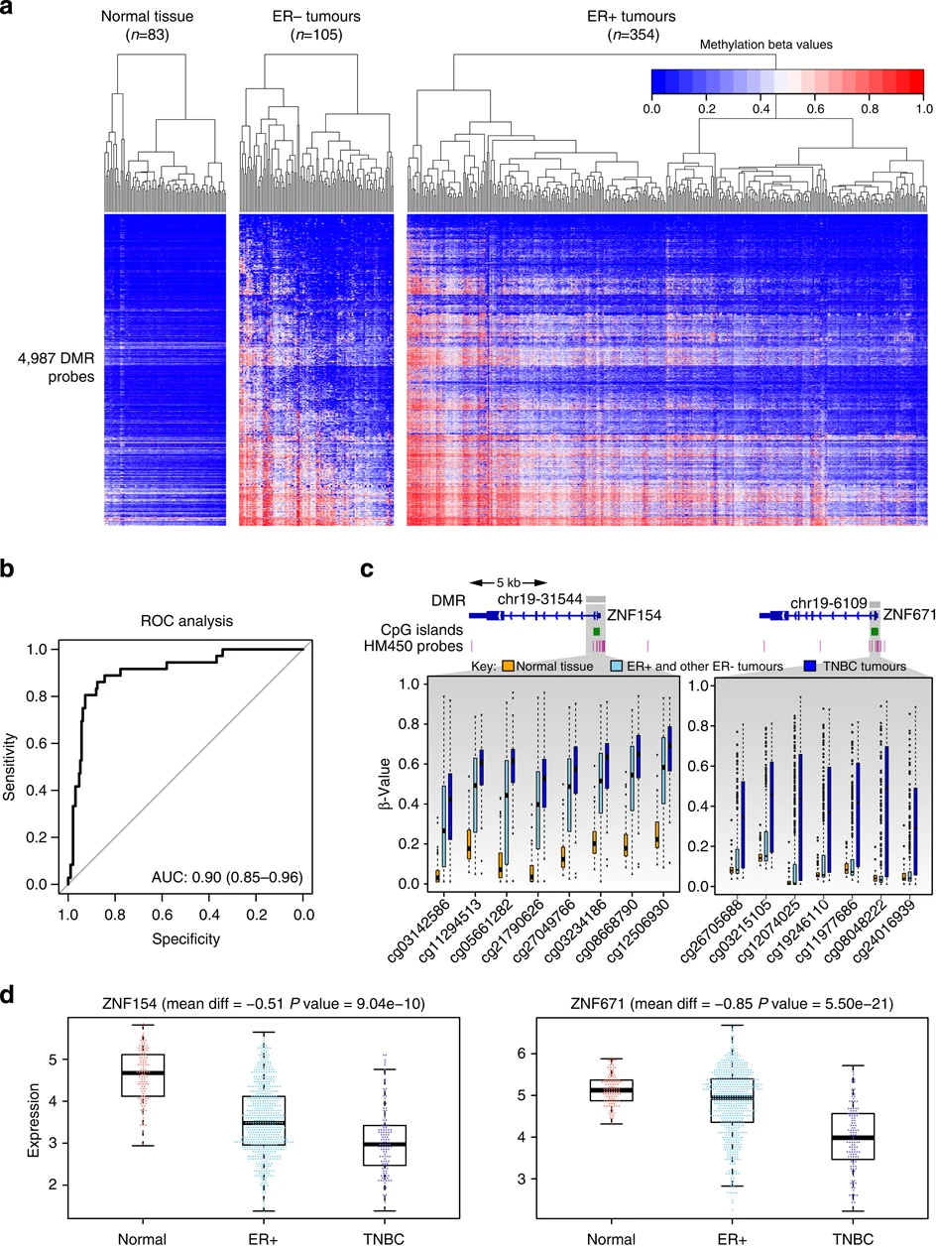
DNA methylation regulate gene expression in breast cancer
Stirzaker C., Zotenko E., Song J.Z., Qu W., Nair S.S., Locke W.J., Stone A., Armstong N.J., Robinson M.D., Dobrovic A... SJ. Clark. Methylome sequencing in triple-negative breast cancer reveals distinct methylation clusters with prognostic value. Nat. Commun. 2015

Slide 33
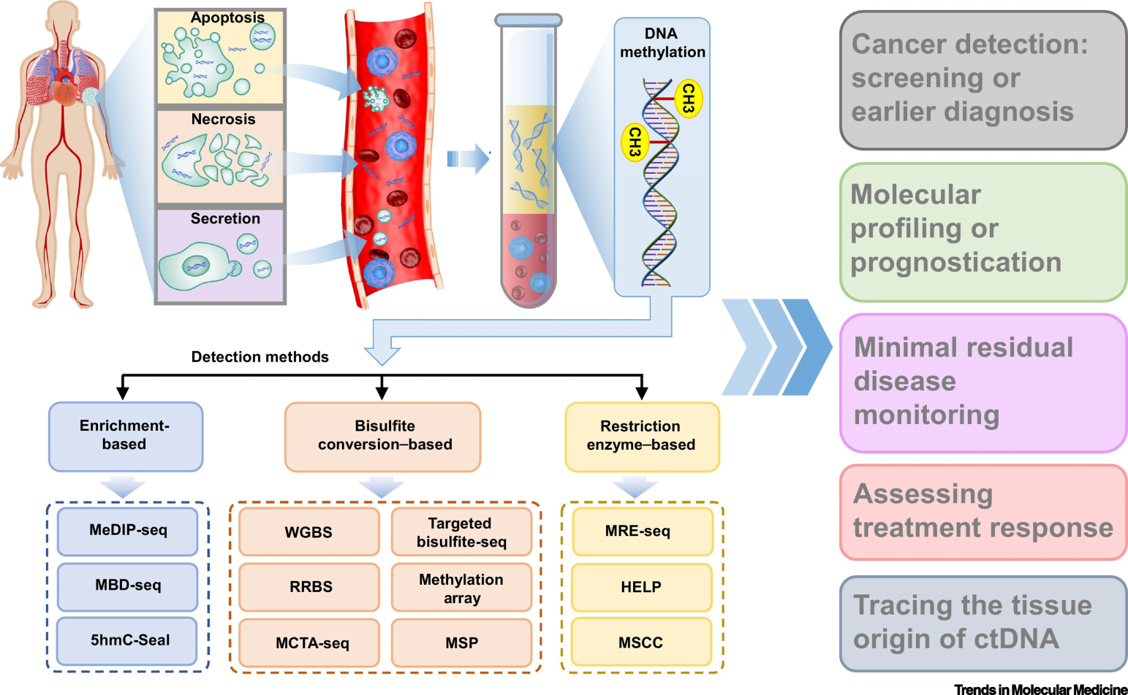
cfDNA and ctDNA
Luo H., Wei W., Ye Z., Zheng J., Xu R. Liquid biopsy of methylation biomarkers in cell-free DNA. Trends Mol. Med. 2021

Slide 34
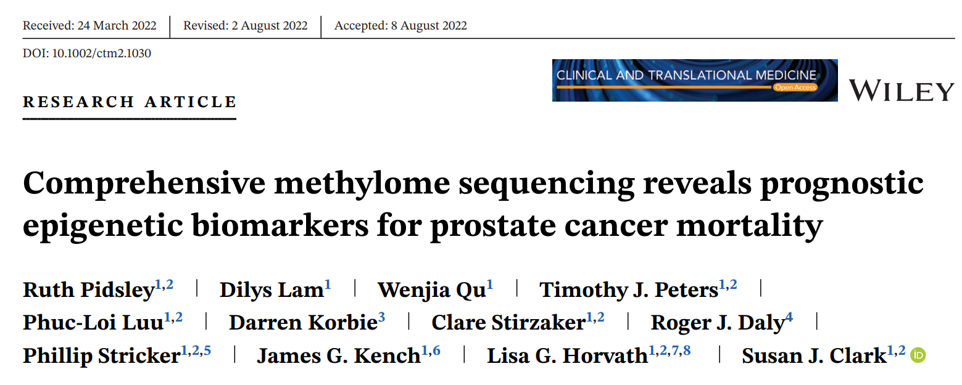
Prognostic epigenetic biomarkers for prostate cancer mortality

Slide 35
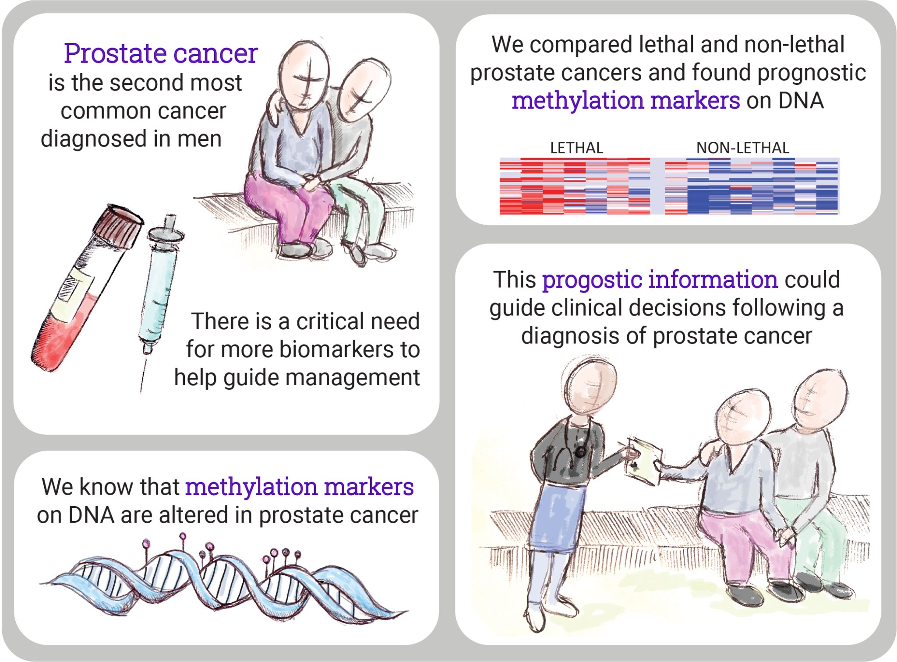
Credit to Dr Kate

Slide 36
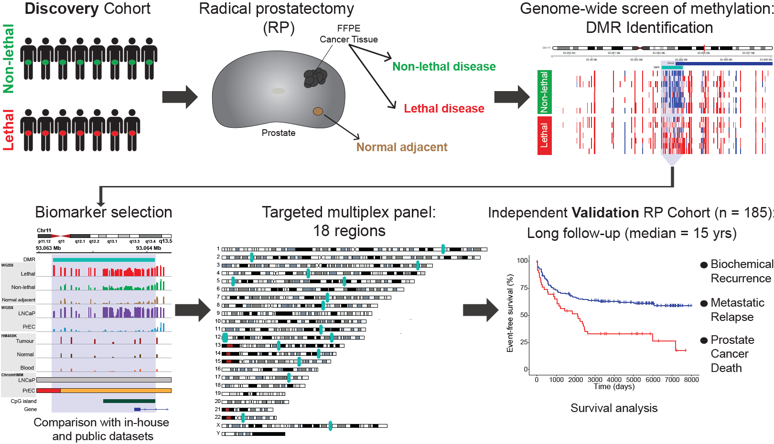
WGBS
Long follow-up (median = 19.5 years)
Long follow-up (median = 15 years)
Notes:
This slide gives an overview of our strategy to identify DNA methylation changes associated with death from prostate cancer. To avoid the limitations of previous studies, we used WGBS in our discovery stage to obtain a more comprehensive assessment of the genome and used 2 cohorts with long-term follow up to allow enough time for metastasis and death to occur: a median of 19.5 years in the discovery and 15 years in the validation cohort.
I’ll now walk you through these steps in more detail and share the results.

Slide 37
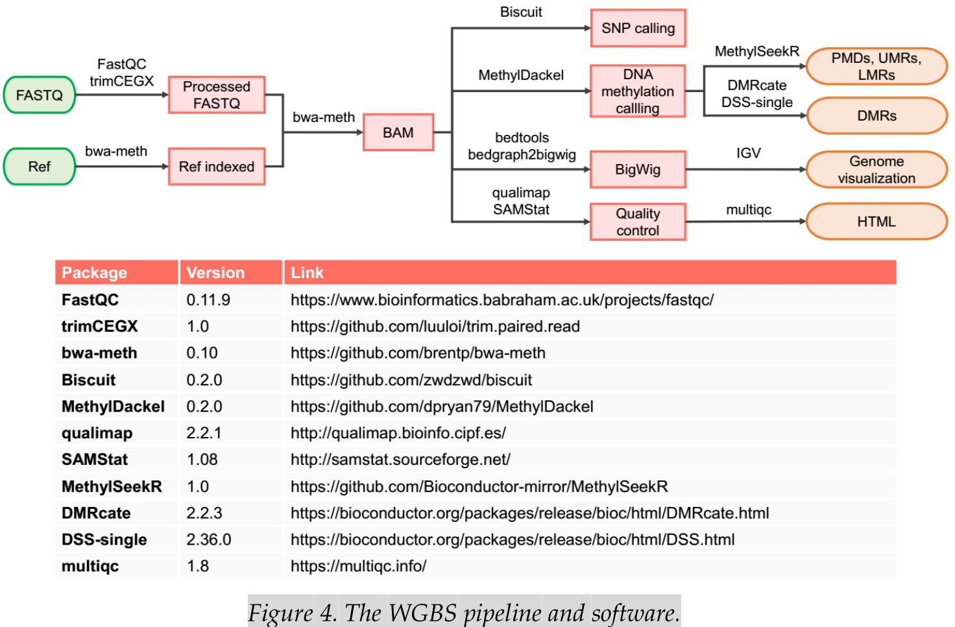
Whole Genome Bisulphite Sequencing pipeline

Slide 38
COVID19 DNA methylation risk (COMER) score for severity classification

Slide 39
Aims
1. Development of COVID-19 Methylation risk (CoMeR) score for Severity
2. Validation and Characterization of CoMeR score
3. ShinyApp for prediction of CoMeR

Slide 40
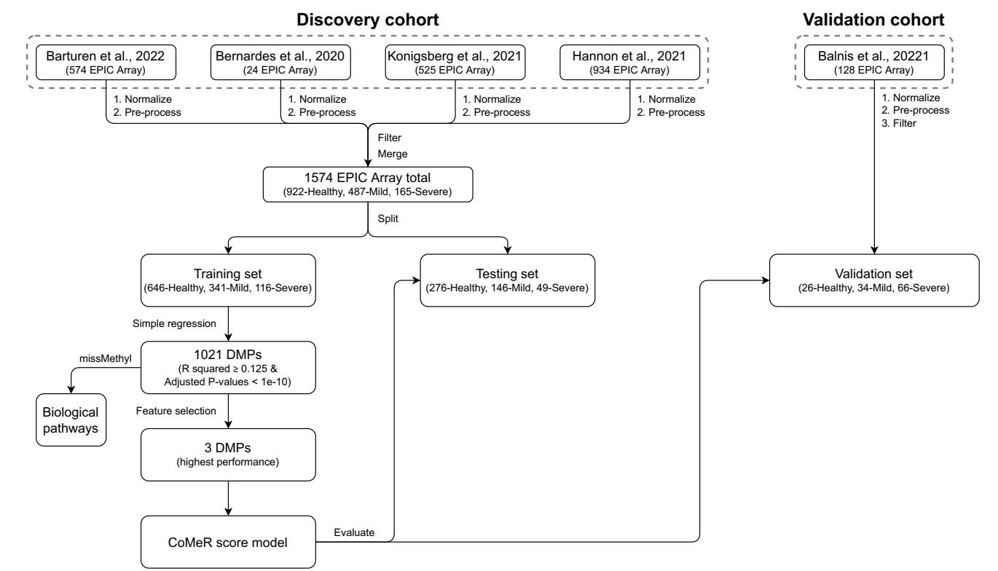

Slide 41
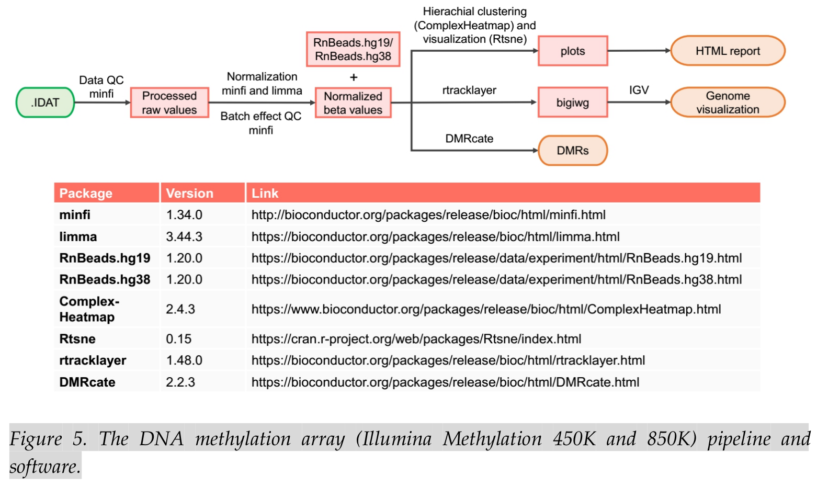
DNA Methylation Array (450K and EPIC/850K) pipeline

Slide 42
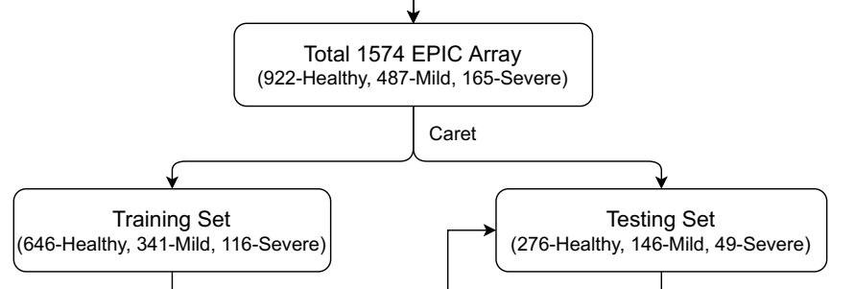
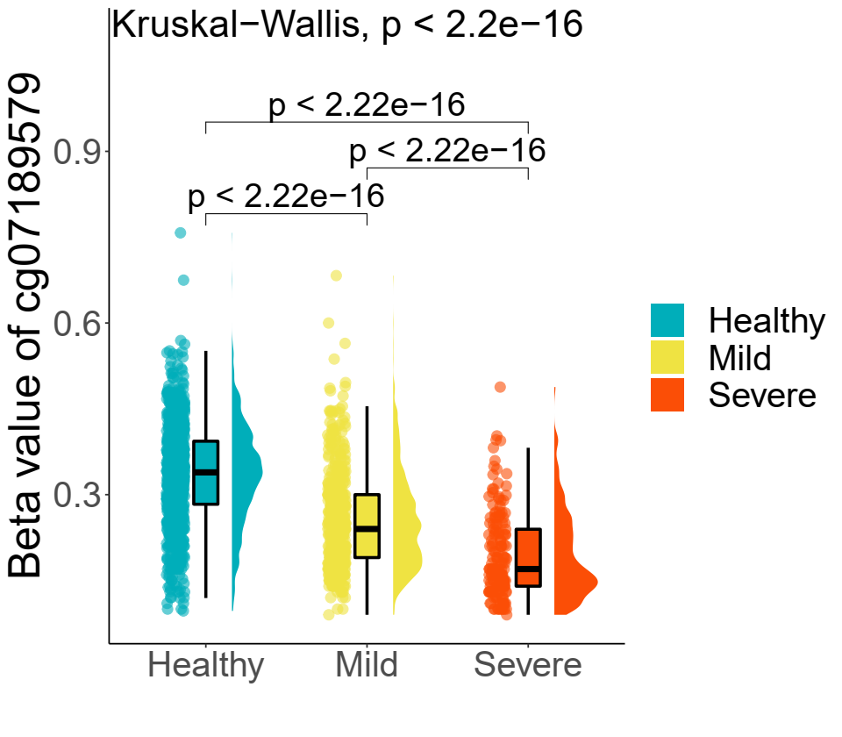

690285 CpGs/sample
 | sample1 | sample2 | ...
cg1
cg2
...
Differentially Methylated Probe (DMP)

Slide 43


Slide 44

Differential Methylation Region (DMR) ~ 500

Slide 45


CoMeR score for diagnosis of COVID-19 patient severity in clinic
Blood sample
B-value of 3 CpG sites
CoMeR score
Severe/Mild
Multiplex bisulfite
ddPCR with 3 amplicons
Compute CoMeR score
Predict
Patient_ID | Cg01 | Cg02 | Cg03
XYZ | 0.34 | 0.84 | 0.53
Patient_ID | Cg01 | Cg02 | Cg03 | CoMeR score | Predicted
XYZ | 0.34 | 0.84 | 0.53 | 0.79 | Severe

Slide 46

DNA methylation-based classification of central nervous system tumours | Nature

Slide 47

The other clinical application of DNA methylation in brain tumors
DNA methylation-based classification of central nervous system tumours | Nature

Slide 48

Methylation classifiers: Brain tumors, sarcomas, and what's next
- Koelsche - 2022 - Genes, Chromosomes and Cancer - Wiley Online Library

Slide 49
THANK YOU FOR YOUR ATTENTION!
Please contact:
Email: luu.p.loi@googlemail.com
Zalo: 0901802182
For further information!

